Slide 1

Project
on
“virtual mouse ”
Presented By:
AMIT KUMAR
ASHWIN JAIN
ASHWINEE JAIN
Submitted To:
Dr.NEELAM CHAPLOT

Slide 2
About Project
Project: VIRTUAL MOUSE
A ’VIRTUAL MOUSE’ is a software component that allows the input of characters without the need for physical mouse.
We propose a novel approach that uses a video device to control the mouse system.
This project removes the requirements of having a physical device to control mouse functions.
Basically the project is based on “Gesture Recognition Technology”.

Slide 3
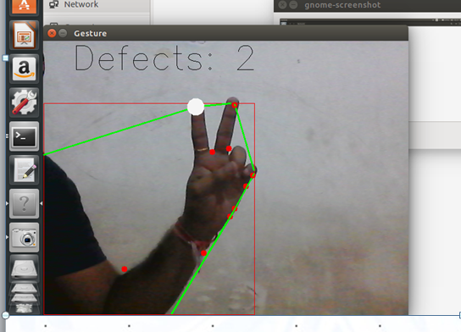
Controlling Mouse
For Cursor Move:- we move the mouse cursor with opening two fingers.

Slide 4
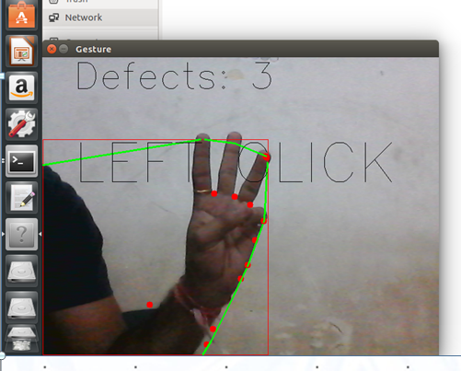
Controlling Mouse
For Left Click:- Open Your 3 Fingers For Left Click

Slide 5
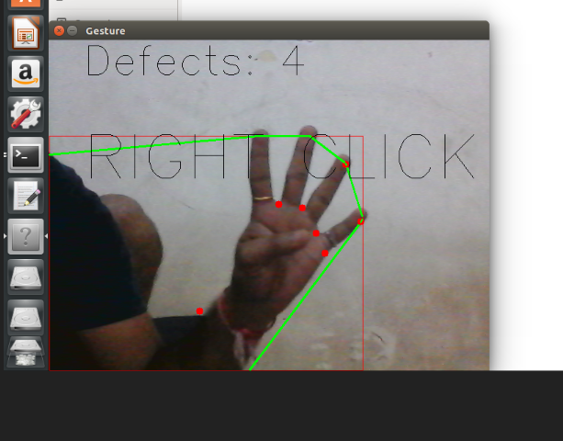
Controlling Mouse
For Right Click:- Open Your 4 Fingers For Right Click

Slide 6
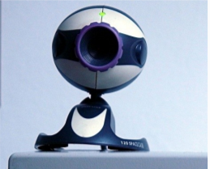
Requirements
Web Cam
Python programming language.
OpenCV (Open Source Computer Vision Library) is a library of programming functions mainly aimed at real-time computer vision.
Anaconda Navigator

Slide 7
Advantages
The main advantage of using hand gestures is to interact with computer as a non-contact human computer input modality.
Reduce hardware cost by eliminating use of mouse.
Convenient for users not comfortable with touchpad.

Slide 8
Limitations
Hand should be in range.
Require a stable surface for the webcam for its proper functioning.
For long time use, it is not comfortable.
Need to use fingers properly.
Lighting should be proper.

Slide 9
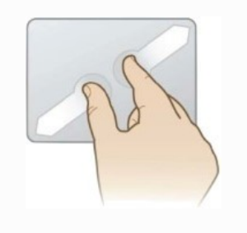
Future Scope
In the future, we plan to add more features such as enlarging and shrinking windows, closing window, etc. by using the palm and multiple fingers
We can also open the browser or any drives (C: /D:/E: etc)with the help of hand gestures instead of moving the cursor

Slide 10
Conclusion
We are developing a system to control the mouse cursor using a real-time camera.
This system is based on computer vision algorithms and can do all mouse tasks.
This system could be useful in presentations and to reduce work space.

Slide 11

THANK YOU

